Slide 1
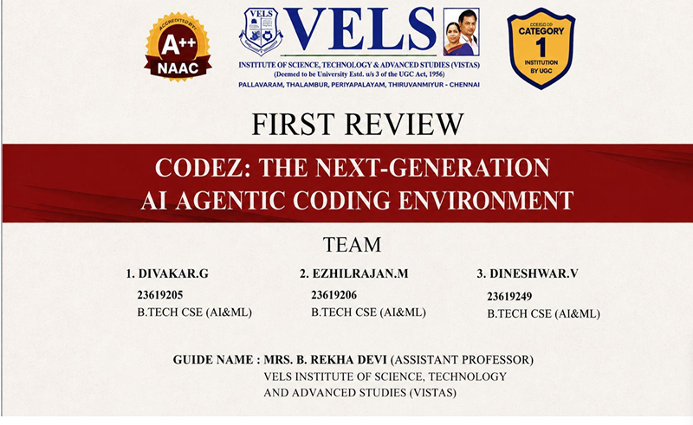
FINAL REVIEW

Slide 2
ABSTRACT
The proliferation of Large Language Models (LLMs) has catalyzed the development of a new generation of Al-powered coding assistants. While these tools have shown great promise in boosting developer productivity, they often operate as extensions within existing Integrated Development Environments (IDEs). This paper introduces Codez, a novel, self-contained framework for an AI coding assistant that runs entirely within the browser, with an optional desktop application wrapper. Codez integrates a feature-rich code editor, a conversational AI chat interface, a file-based context management system, and a live preview environment into a single, cohesive web application. We detail its full-stack architecture, which leverages Remix, React, and Vite on the frontend, and Cloudflare Workers for a scalable, serverless backend. We provide a deep analysis of its most complex components, identifying significant software engineering challenges related to component complexity, state management, and security. Our analysis indicates that while the framework is powerful, its long-term maintainability is contingent on significant refactoring and the introduction of a comprehensive testing strategy

Slide 3
INTRODUCTION
What is Codez?
01 Codez is a standalone AI-powered coding environment for software development.
02 It combines AI chat, code editor, project files and live preview in one workspace.
03 Unlike traditional AI coding assistants, Codez primarily operates through a web browser.
04 It can also be packaged as a desktop application using Electron.
05 The system uses LLMs to understand project context and assist developers with coding tasks.

Slide 4
LITERATURE SURVEY
1. Peng et al. (2023)
Title: The Impact of AI on Developer Productivity: Evidence from GitHub Copilot
Main Focus: Studies how AI coding assistance affects developer productivity.
Limitation: Productivity improvements do not necessarily guarantee better code quality; human review and validation are still required.
2. Fan et al. (2023)
Title: Large Language Models for Software Engineering: Survey and Open Problems
Main Focus: Reviews LLM applications in coding, testing, repair, refactoring, documentation, and other software engineering tasks.
Limitation: Hallucinations and incorrect solutions remain major challenges, requiring reliable verification.

Slide 5
LITERATURE SURVEY
3. Hou et al. (2024)
Title: Large Language Models for Software Engineering: A Systematic Literature Review
Main Focus: Provides a systematic review of research on LLMs in software engineering.
Limitation: Important gaps remain in evaluation, context handling, reliability, and practical deployment.
4. Zhang et al. (2023)
Title: A Survey on Large Language Models for Software Engineering
Main Focus: Reviews the use of LLMs across software engineering tasks and discusses security and reliability.
Limitation: Security, reliability, evaluation, benchmarking, and domain adaptation remain open challenges.

Slide 6
PROBLEM STATEMENT
Developers switch between IDEs, AI assistants, terminals and preview tools.
Existing AI assistants are commonly dependent on installed desktop IDEs.
Large codebases make it difficult to provide the correct context to an LLM.
Sending the complete codebase increases token usage, cost and latency.
Browser-based systems introduce additional concerns such as API-key security and network latency.
Complex AI applications also face maintainability, testing and state-management challenges.

Slide 7
OBJECTIVES
Develop a standalone, browser-based AI coding environment.
Integrate conversational AI with a complete coding workspace.
Provide project-wide file and code context to the AI.
Select only relevant files before sending the final request to the LLM.
Reduce unnecessary prompt tokens and improve context quality.
Support multiple LLM providers through a unified API.
Provide an optional desktop application through Electron.

Slide 8
RESEARCH GAP
Most AI coding assistants operate as extensions of existing IDEs.
General browser IDEs do not necessarily provide deep AI integration.
Large project context can make LLM requests expensive and inefficient.
Security becomes important when browser applications handle API keys and user code.
Complex AI coding systems require better modularity, testing and type safety.

Slide 9
PROPOSED SYSTEM
The proposed system, Codez, is a standalone AI-powered coding environment designed to provide an integrated development experience within a web browser. It combines conversational AI, project file management, code editing, context management, and live preview in a single workspace. When a user submits a coding request, the system analyzes the conversation and available project files, summarizes lengthy conversation history, and identifies the most relevant files using context-selection techniques. The selected context is then provided to the Large Language Model (LLM), which generates and streams the response back to the user. Codez supports multiple LLM providers through a unified API and uses technologies such as Remix, React, Vite, Cloudflare Workers, CodeMirror, and Electron. The system also provides an optional desktop application and aims to reduce unnecessary context, improve AI response relevance, and provide a more convenient and integrated coding experience.

Slide 10
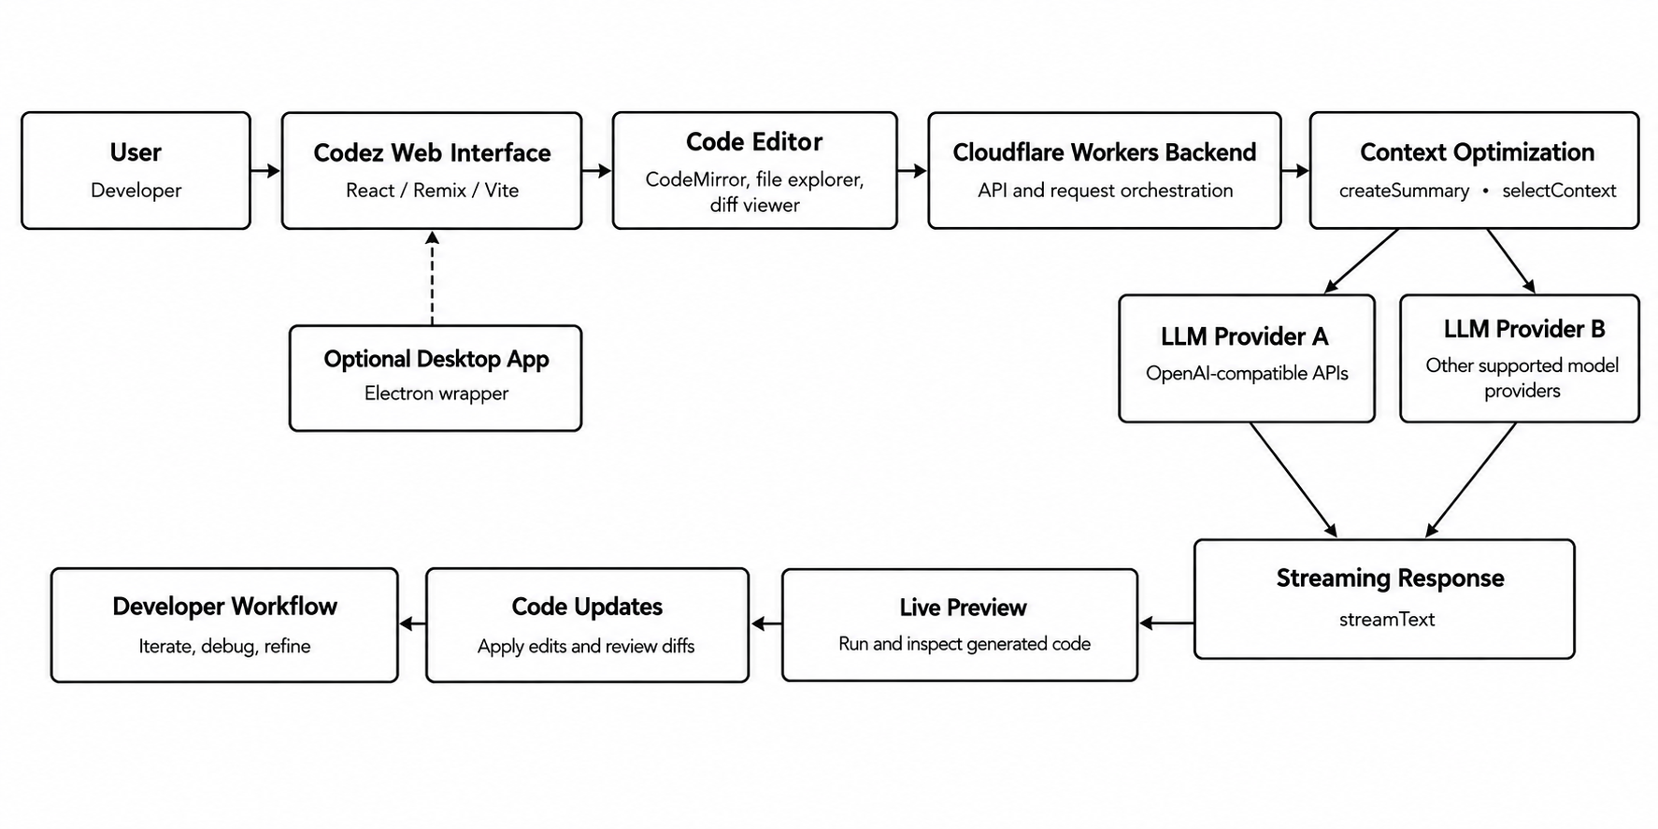
System Architecture

Slide 11
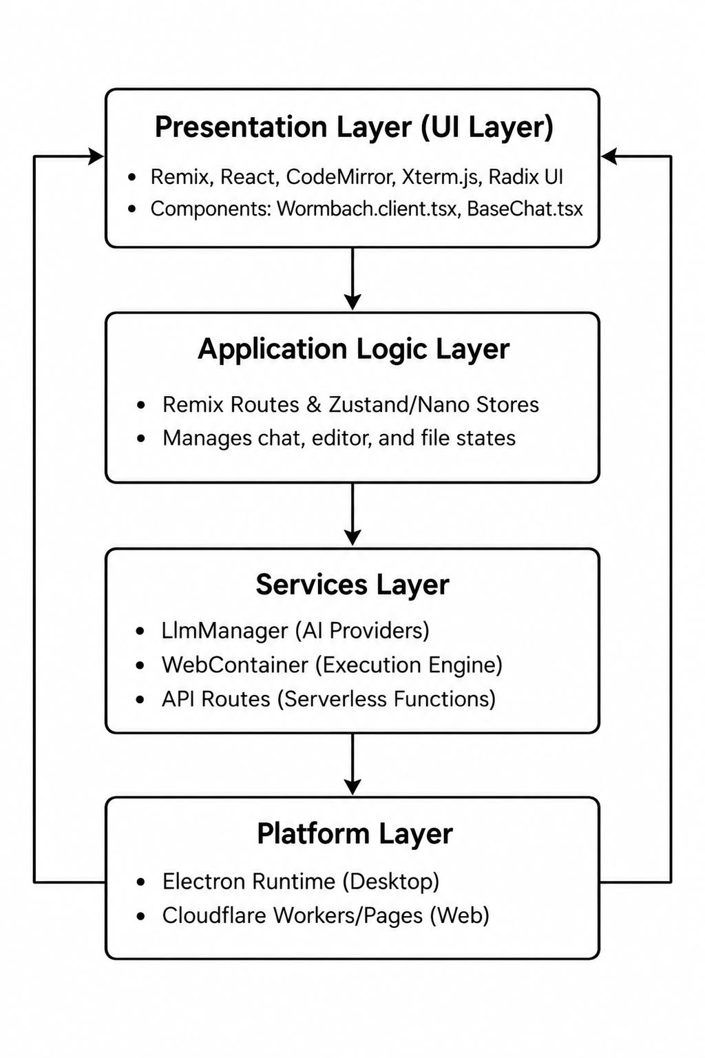
FLOW CHART

Slide 12
Key Features
AI Conversational Coding
Project-Wide Context
File Explorer and Workspace Management
CodeMirror Code Editor
Diff Viewer
Live Web Preview
Multiple LLM Provider Support
Context Optimization
Optional Electron Desktop Application

Slide 13
Module-Wise Implementation
1. Chat Module
Provides an AI-powered conversation interface for users.
Supports real-time streaming responses from the AI.
2. Workspace Module
Manages project files and directory structure.
Supports file creation, organization, and management.
3. Context Module
Summarizes conversations to maintain relevant context.
Selects relevant project files for AI prompts.
4. AI Backend
Handles AI requests through the /api/chat endpoint.
Manages communication with LLM providers.

Slide 14
Module-Wise Implementation
5. Code Editor Module
Provides code editing using the CodeMirror editor.
Supports code navigation and editing within the workspace.
6. Preview Module
Provides a live preview of web applications.
Allows users to run and inspect generated code.
7. Electron Module
Supports a desktop application using Electron.
Extends the browser-based environment to desktop platforms.
8. Quality Module
Focuses on testing and improving type safety.
Enhances code maintainability and reliability.

Slide 15
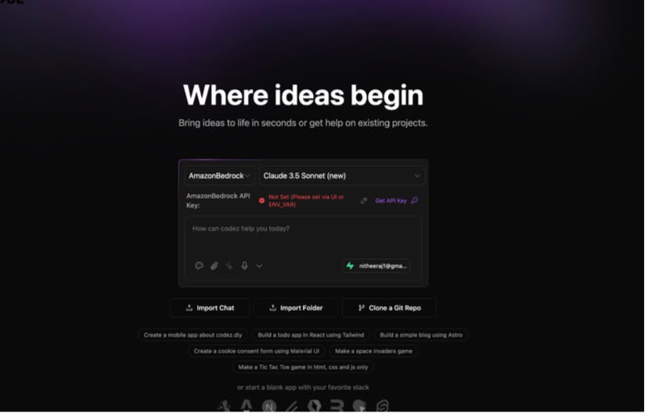
IMPLEMENTION

Slide 16
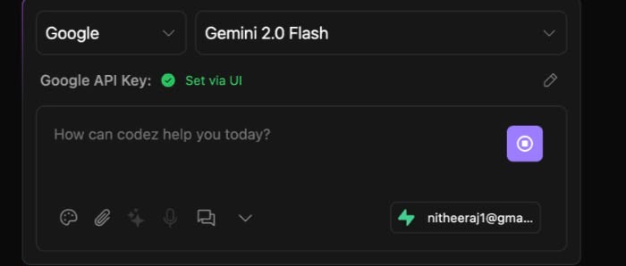
IMPLEMENTION

Slide 17
Experiments and Results
Naive Full-Codebase Context
Average prompt size: 12,450 tokens
Codez Context Optimization
Average prompt size: 3,120 tokens
Key Result
Approximately 75% reduction in prompt tokens.
Response Quality
Initial evaluation: 3.8 / 5.0
Codez evaluation: 4.5 / 5.0

Slide 18
Challenges, Future Work
Challenges
Large and complex frontend components.
Use of @ts-nocheck reduces TypeScript safety.
Limited automated testing in critical components.
Browser API-key handling.
Network latency.
Future Work
Refactor large components.
Adopt strict TypeScript practices.
Add comprehensive automated testing.
Perform larger quantitative evaluations.
Improve API-key management.
Explore OAuth and secure secrets management.

Slide 19
Conclusion
Codez is an AI-powered coding environment designed to simplify software development through intelligent conversations, efficient project file management, and context-aware AI assistance. It integrates a CodeMirror-based editor, live web preview, and LLM communication to support an interactive coding workflow. With conversation summarization, relevant file selection, and optional Electron desktop support, Codez aims to improve development efficiency and usability while focusing on testing, type safety, and maintainability for future enhancements.

Slide 20
REFERENCES
1. Bissyande, T. F., et al. (2024). How Do Programmers Use AI-based Code Assistants? A
Survey. arXiv preprint arXiv:2402.18429.
2. Wolf, T. G., et al. (2024). AutoCommenter: A Context-Aware AI Assistant for Code
Review. arXiv preprint arXiv:2401.01421.
3. Al-Zaim, S., et al. (2016). A Survey on Web-Based IDEs. International Journal of
Computer Applications, 138(10), 26–31.
4. Doe, J. (2023). A Performance Comparison of In-Browser and Native Integrated
Development Environments. Journal of Cloud Computing, 5(1), 1–15.
5. Smith, A. B., & Jones, C. D. (2024). A Systematic Evaluation of Web Browser
Vulnerabilities. In Proceedings of the 2024 IEEE Symposium on Security and Privacy
(pp. 1–15).

